Slide 1
Solid Electricity
Zero Carbon Marine Shipping
via
Aluminium-Water Combustion

Slide 2
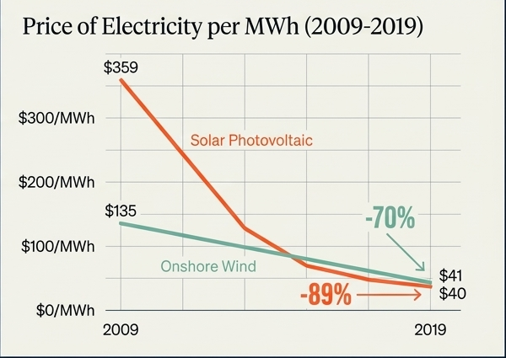
The Energy Transition
THE DE-CARBONISATION CHALLENGE
80% of global commerce relies on marine shipping
70-80% reduction mandate by the IMO

Slide 3
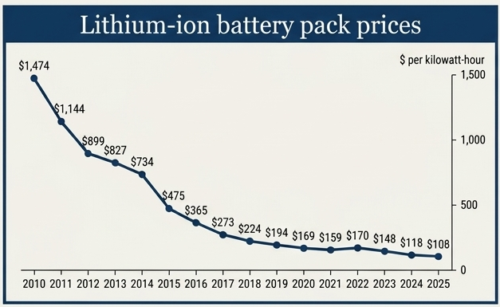
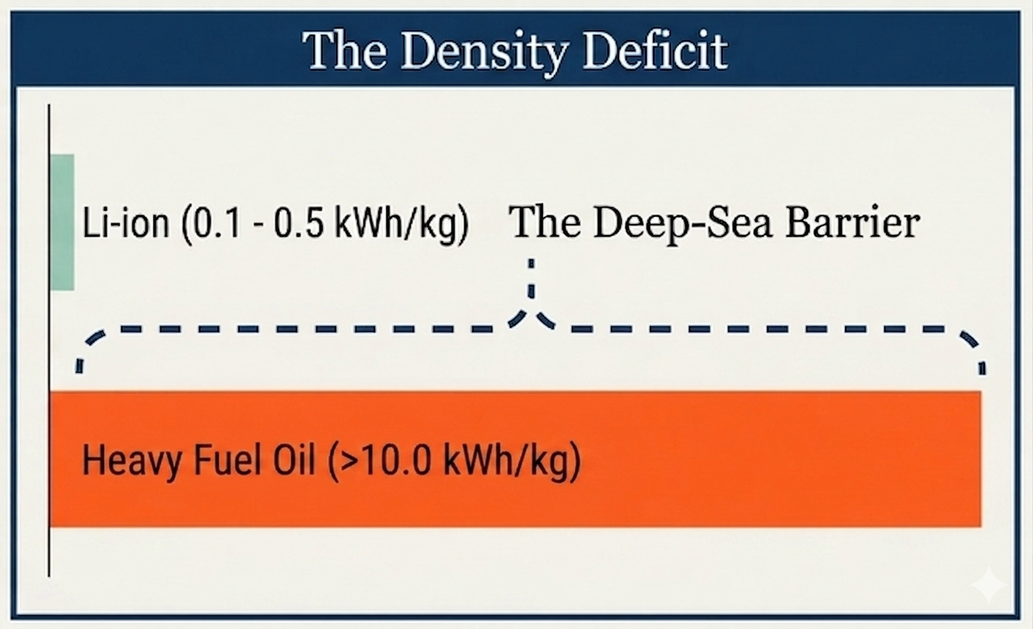
THE LIMITS OF LITHIUM-ION BATTERIES

Slide 4
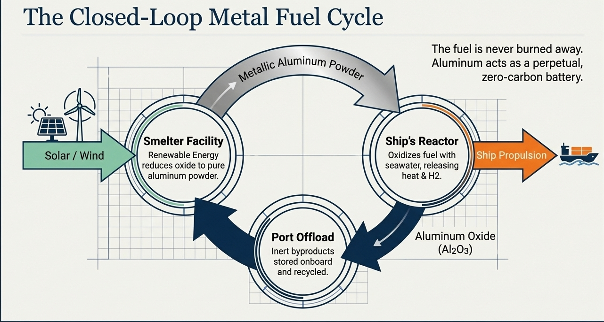
Aluminium as Marine Fuel

Slide 5
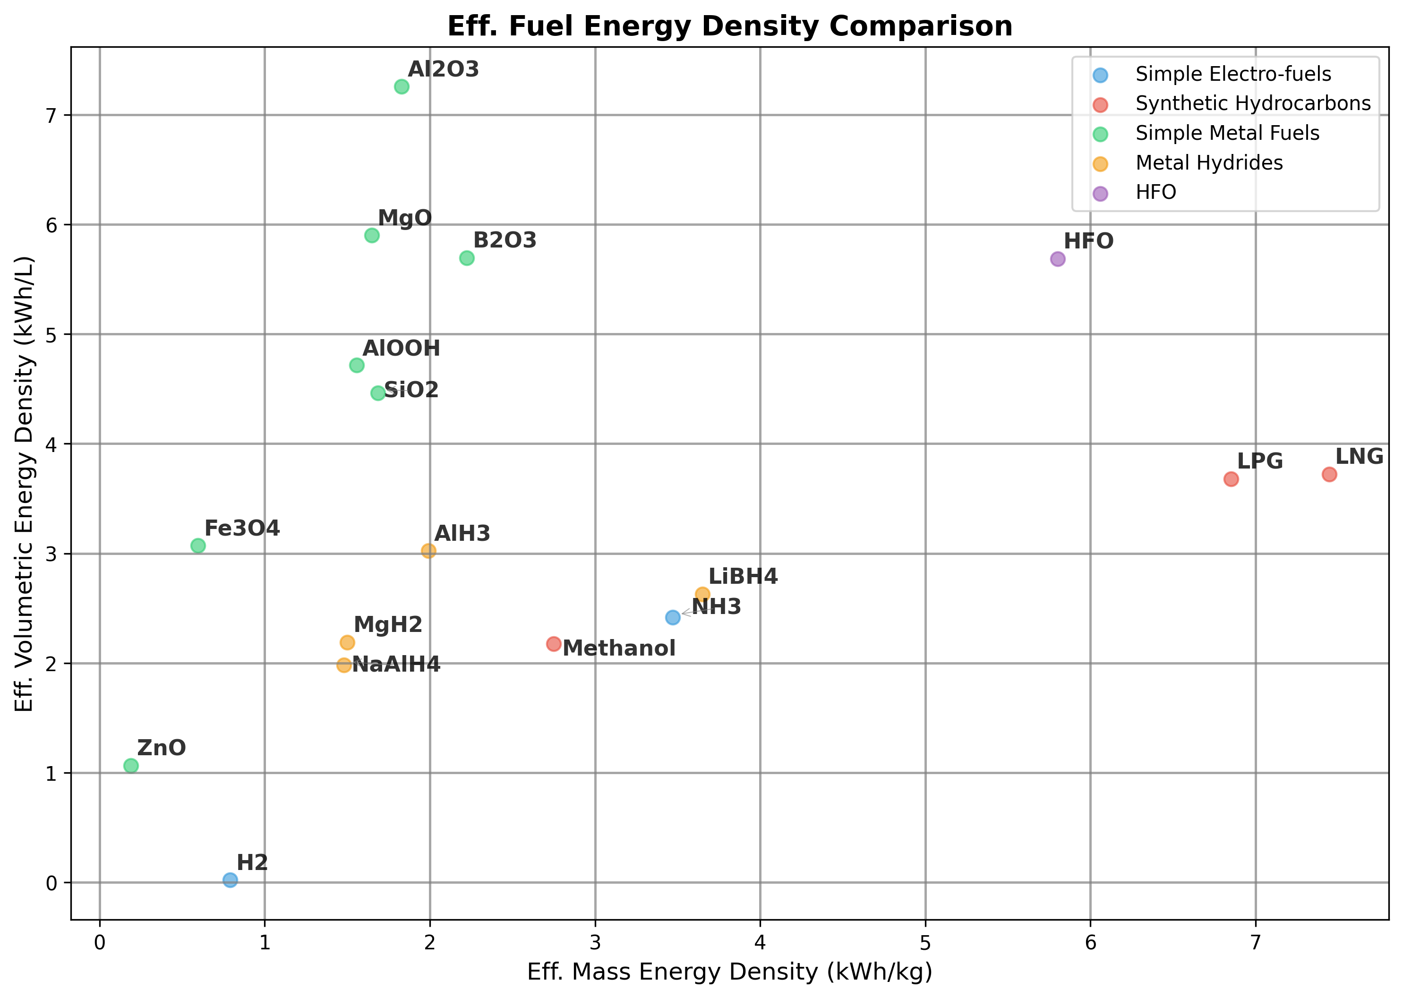
Eff. Energy Density Analysis

Slide 6
This work is licensed under a Creative Commons Attribution-ShareAlike 3.0 Unported License.
It makes use of the works of Mateus Machado Luna.

